Slide 1
Estockvel
HOW THE APP WORKS STEP BY STEP

Slide 2
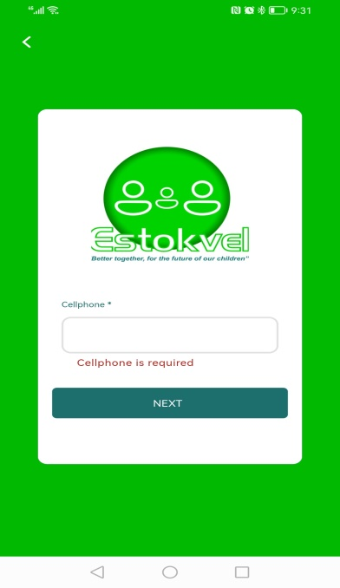
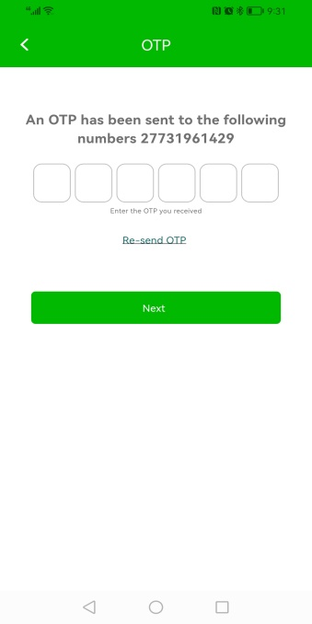
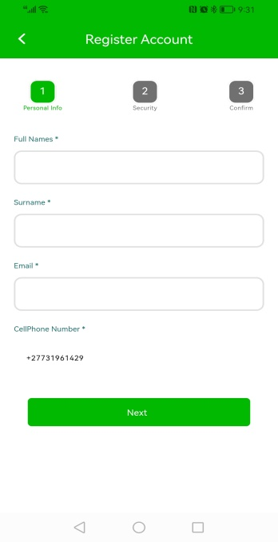
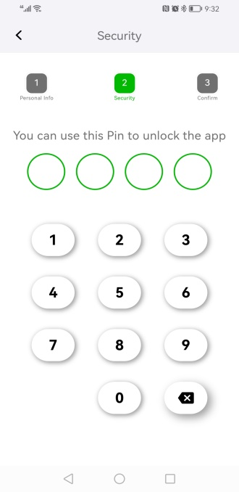
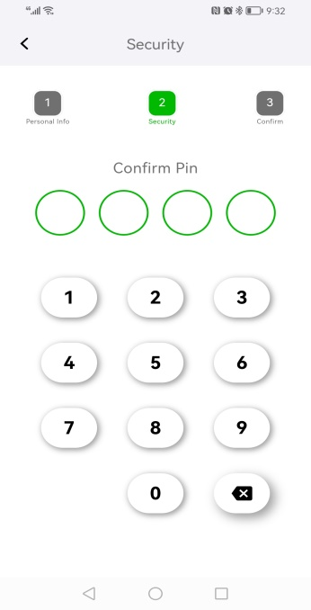
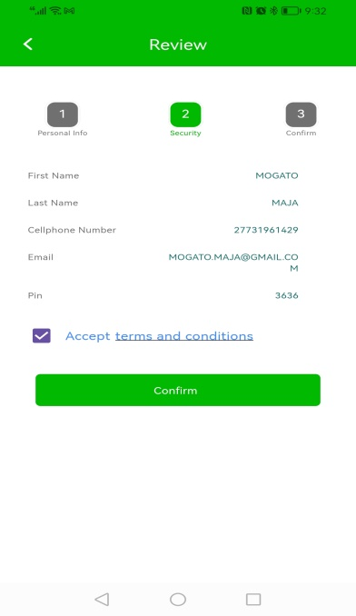
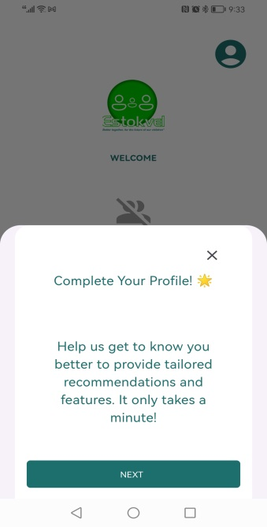
STEP 1 – SIGN IN
1.1 ENTER PHONE NUMBER
1.2 ENTER 123456
1.3 ENTER BELOW INFO
1.4 ENTER SECURITY PIN
1.5 CONFIRM SECURITY PIN
1.6 ACCEPT TERMS & CONDITIONS
1.7 COMPLETE YOUR PROFILE

Slide 3
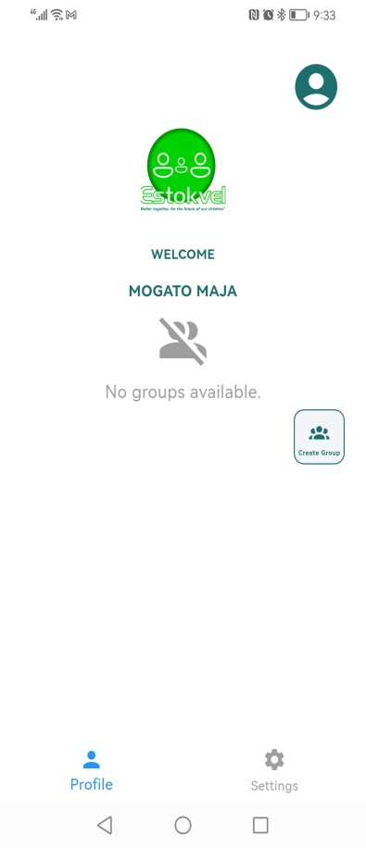
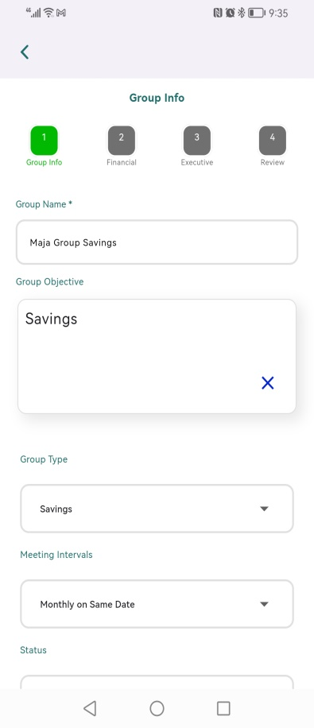
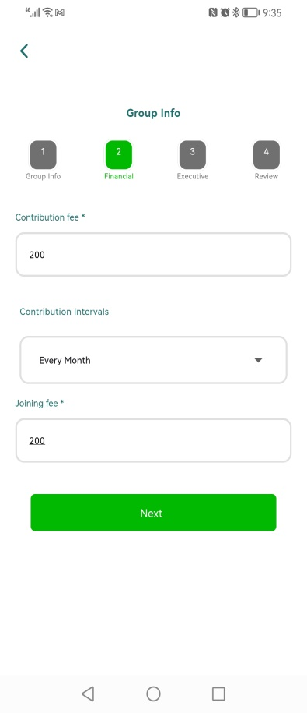
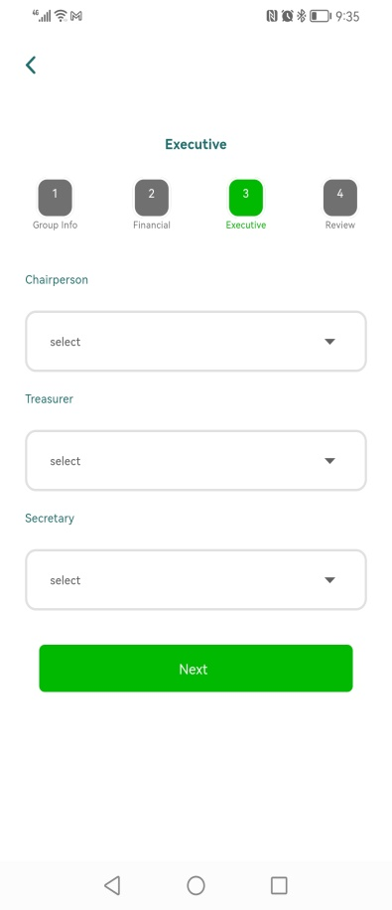
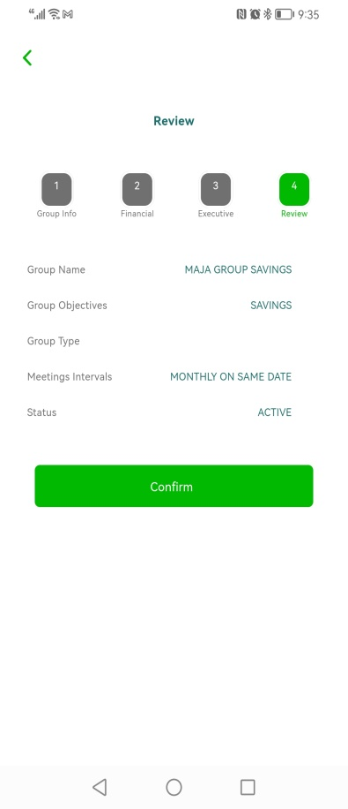
STEP 2 – CREATE A GROUP
2.3 CLICK NEXT TO SKIP LOADING EXECUTIVES INFO
2.4 REVIEW & CLICK CONFIRM TO SAVE GROUP INFO
2.1 CREATE A GROUP
2.2 ENTER GROUP INFORMATION

Slide 4
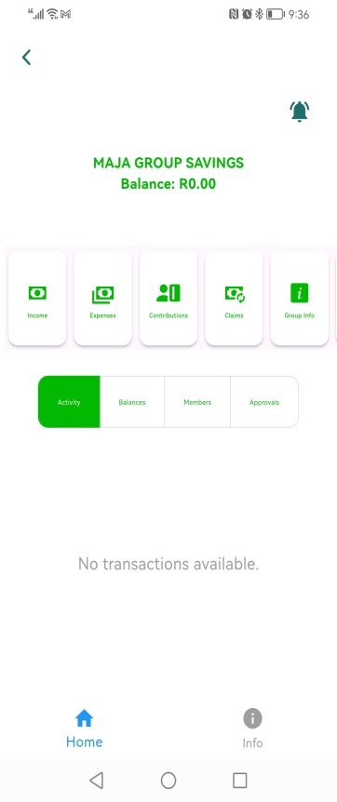
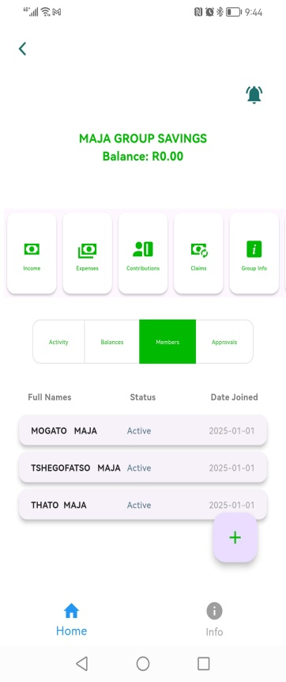
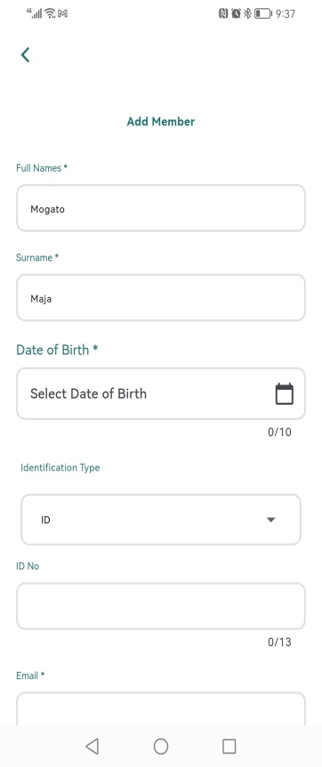
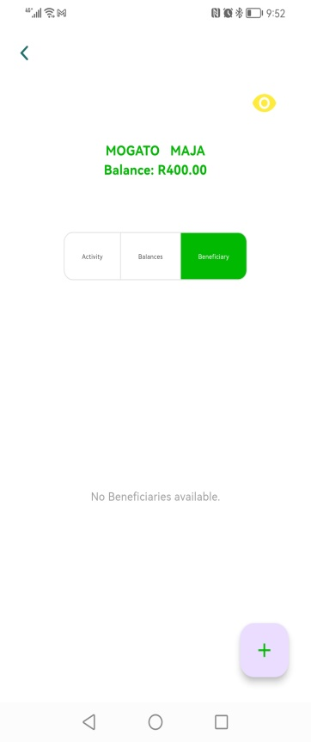
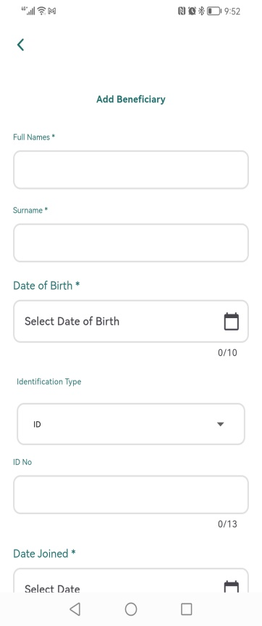
STEP 3 – ADD MEMBERS AND BENEFICIARIES
3.2 ADD MEMBER DETAILS AND SAVE
3.4 SELECT MEMBER, CLICK ON “+” TO ADD BENEFICIARY
3.5 ADD BENEFICIARY DETAILS & SAVE
3.1 SELECT MEMBER TAB, CLICK ON “+” TO ADD A MEMBER

Slide 5
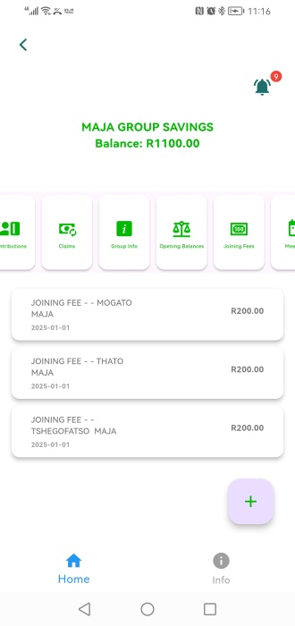
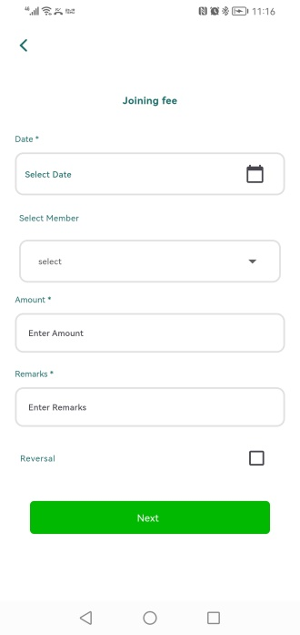
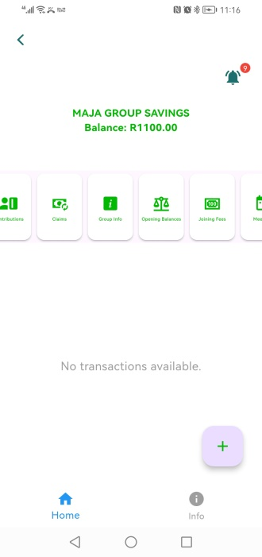
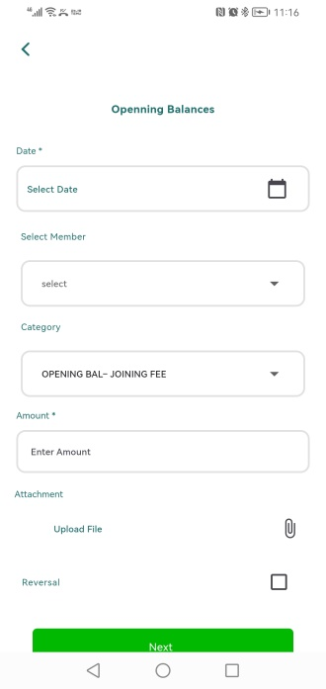
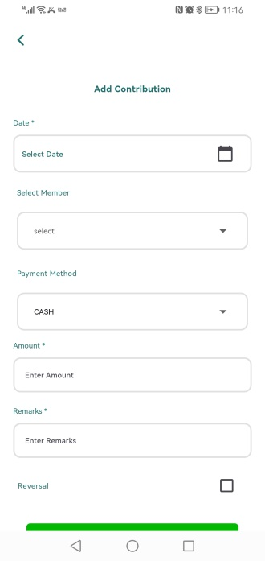
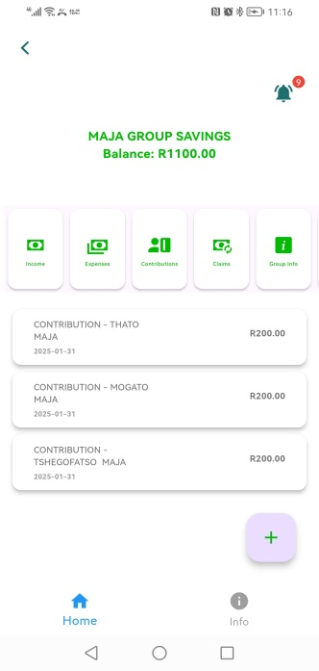
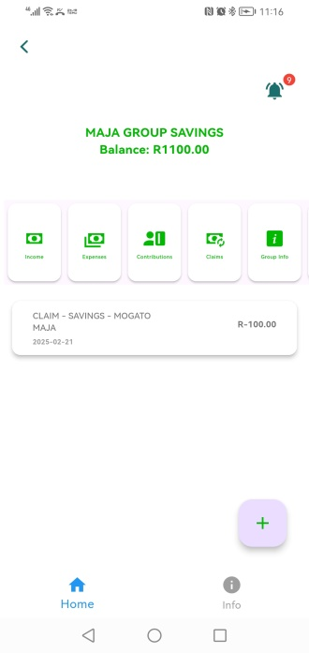
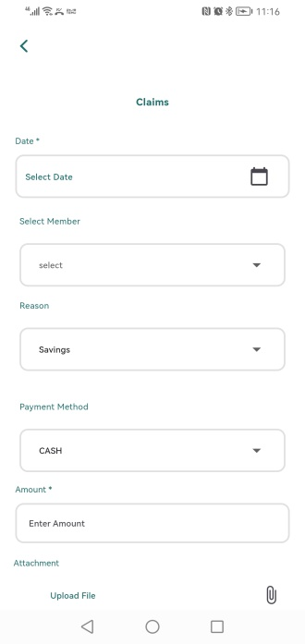
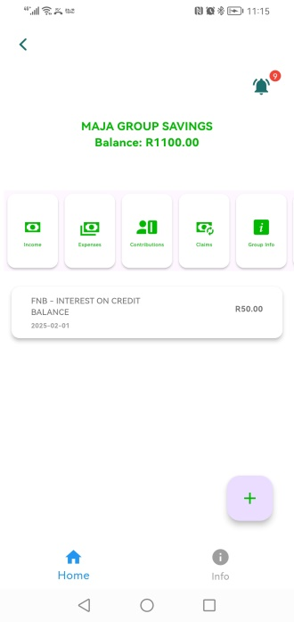
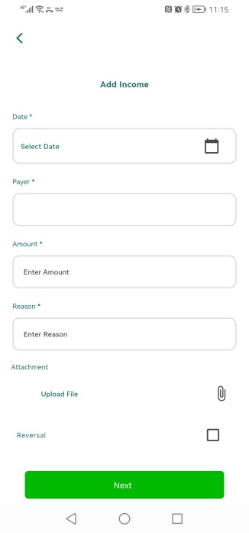

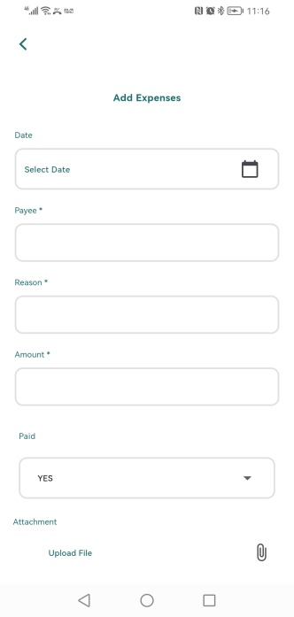
STEP 4 – START PROCESSING CONTRIBUTIONS, CLAIMS, JOINING FEES, OPENING BALANCES,INCOME & EXPENSES
4.1 SELECT JOINING FEE TAB, CLICK ON “+” TO ADD RECORD AND SAVE
4.2 SELECT OPENING BALANCES TAB, CLICK ON “+” TO ADD RECORD AND SAVE
4.3 SELECT CONTRIBUTIONS TAB, CLICK ON “+” TO ADD RECORD AND SAVE
4.4 SELECT CLAIMS TAB, CLICK ON “+” TO ADD RECORD AND SAVE
4.5 SELECT INCOMES TAB, CLICK ON “+” TO ADD RECORD AND SAVE
4.6 SELECT EXPENSES TAB, CLICK ON “+” TO ADD RECORD AND SAVE

Slide 6
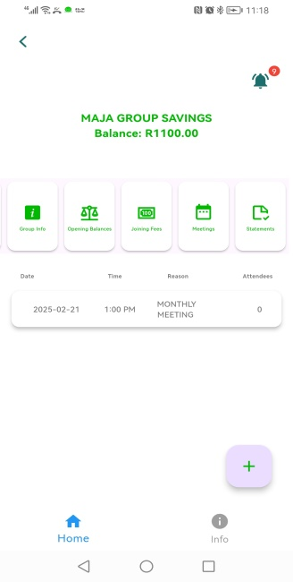
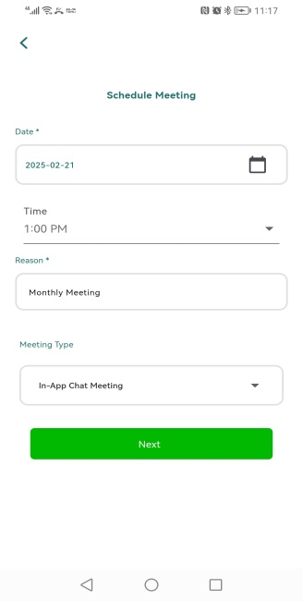
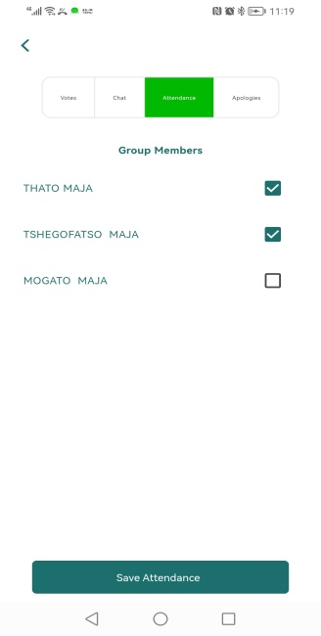
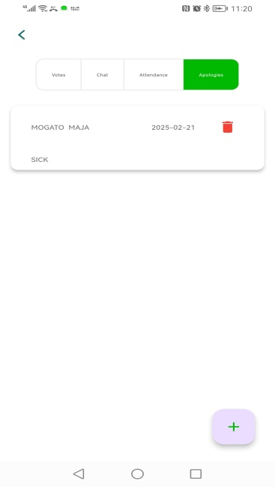
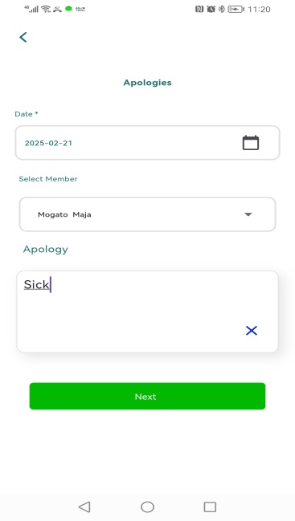
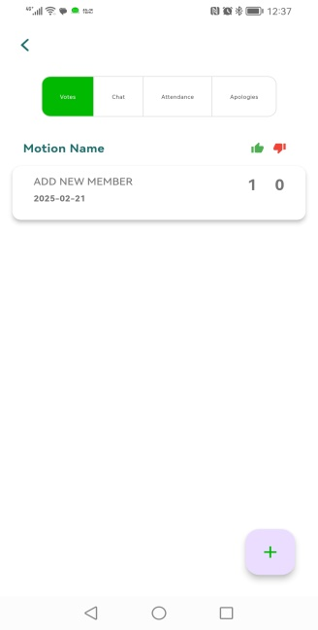
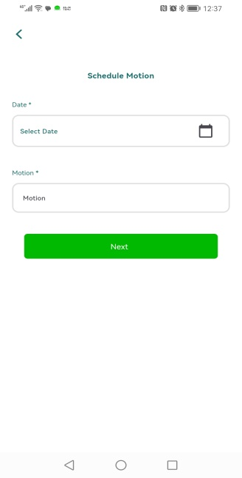
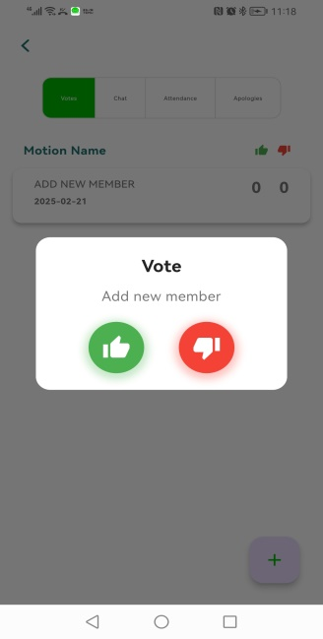
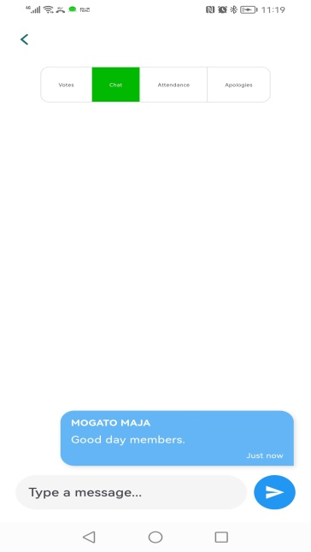
STEP 5 – SHEDULE MEETINGS, ADD MEETING RESOLUTIONS, VOTE ON RESOLUTIONS, RECORD ATTENDANCE REGISTER AND CHAT WITH MEMBERS
5.1 SELECT MEETINGS FROM THE MAIN MENU, CLICK ON “+” TO SCHEDULE MEETING
5.2 ADD MEETING DETAILS AND SAVE
5.3 RECORD ATTENDANCE REGISTER
5.4 CLICK ON “+” TO ADD AN APOLOGY FOR ABSENT MEMBER, THEN ENTER APOLOGY INFORMATION AND SAVE
5.5 TO ADD A MEETING RESOLUTION/MOTION CLICK ON “+”
5.6 ADD MOTION/RESOLUTION INFORMATION AND SAVE
5.7 TO VOTE ON RESOLUTION/MOTION. CLICK ON IT AND VOTE
5.8 START CHATING WITH OTHER MEMBERS CLICK ON CHAT.

Slide 7
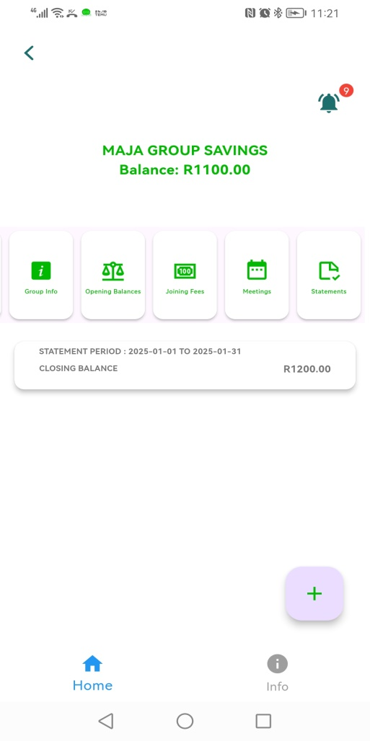
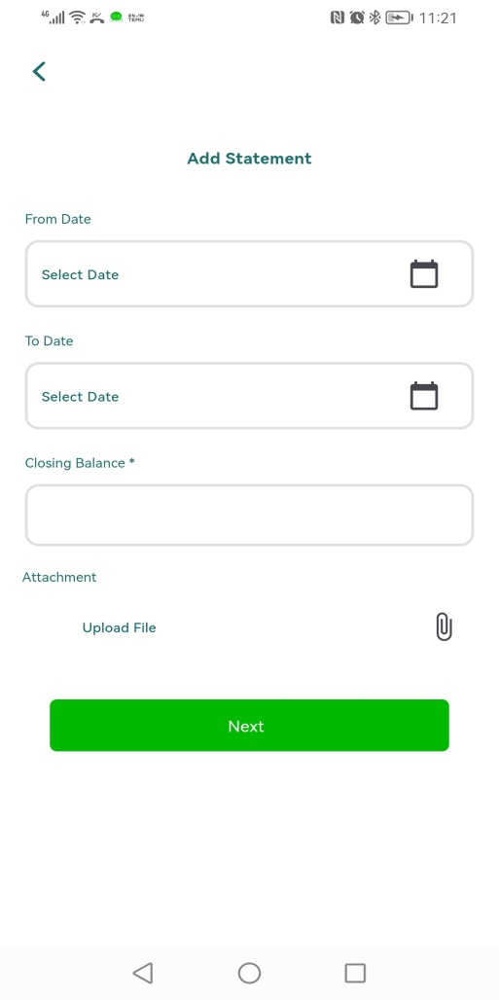
STEP 6 – ADD MONTHLY BANK STATEMENTS
6.1 TO ADD A COPY OF MONTHLY STATEMENT CLICK ON “+”
6.2 ADD STATEMENT INFORMATION, ATTACH A COPY AND SAVE.

